Slide 1
Mrs. Walker’s
Classroom Rules

Slide 2

Raise your hand for
permission
to speak
After the bell rings there should be no talking to your friends, classmates, or teacher without permission.

Slide 3
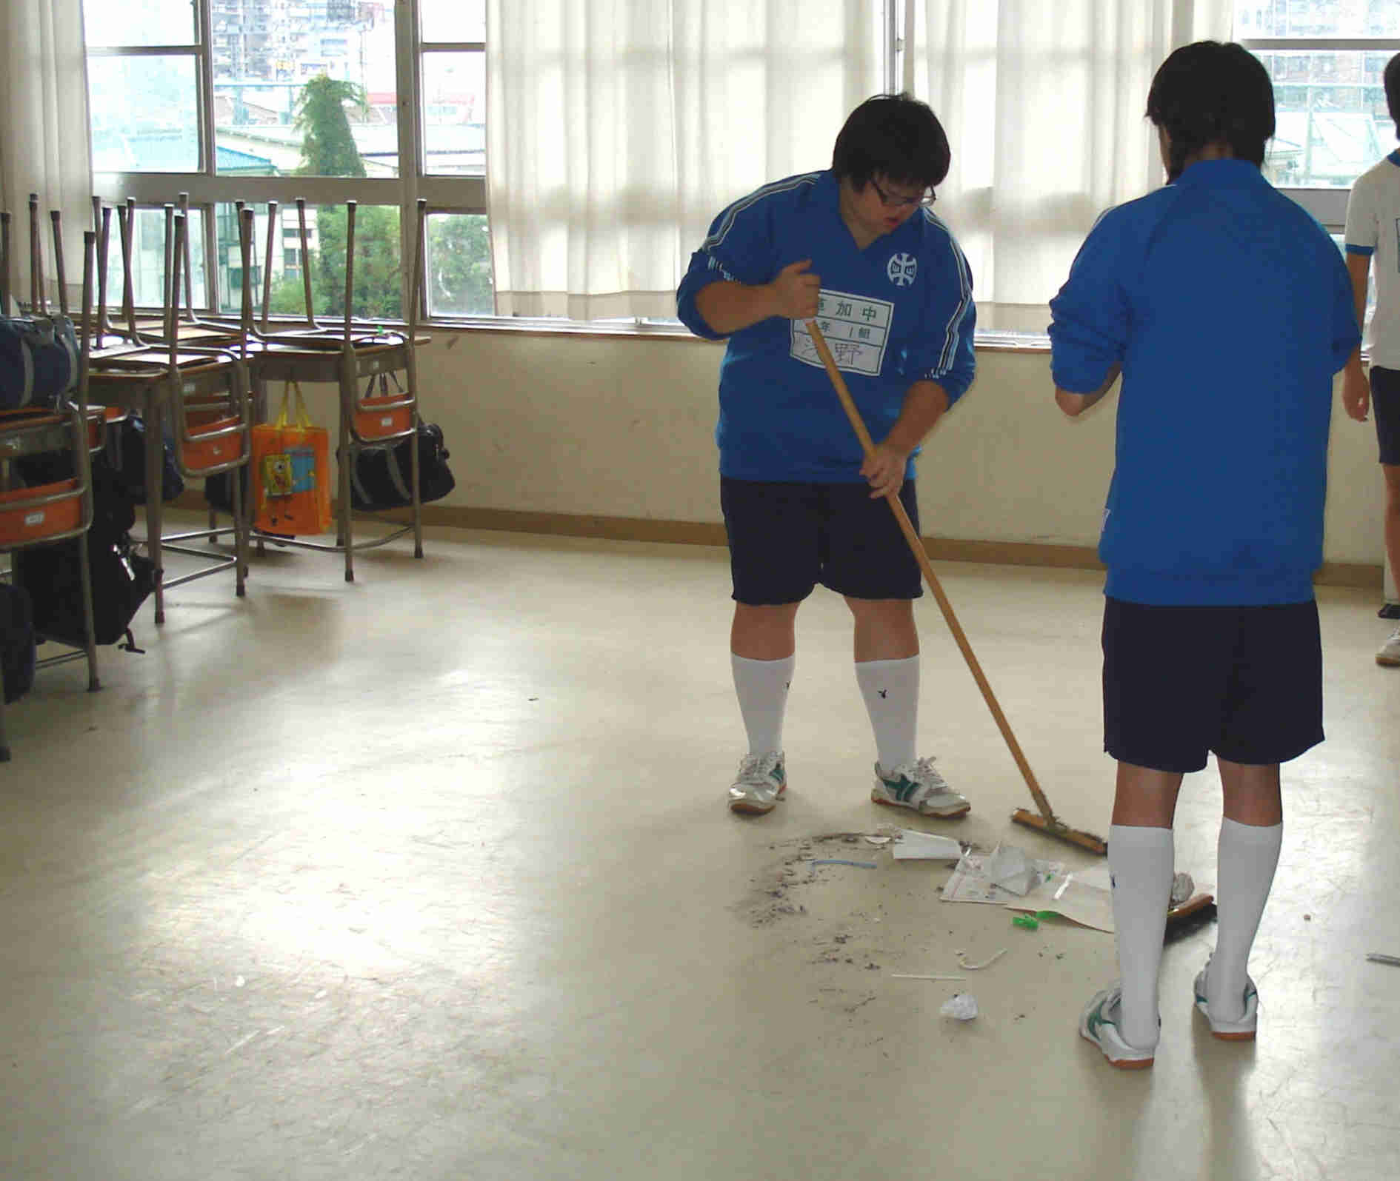
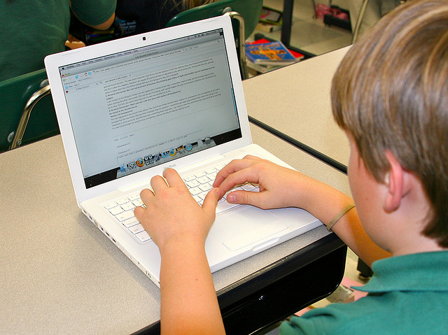

Respect yourself: Do what is right, do your own work, tell the truth, and try your hardest.
Respect others: Be kind and courteous to everyone, stay on task without disturbing or distracting others, and do not use ‘put downs’ or harass others.
Respect your school: Do not write on tables, take care of the equipment, take care of things that you borrow, and clean up after yourself.
Respect :
respect yourself, respect others, respect your school

Slide 4

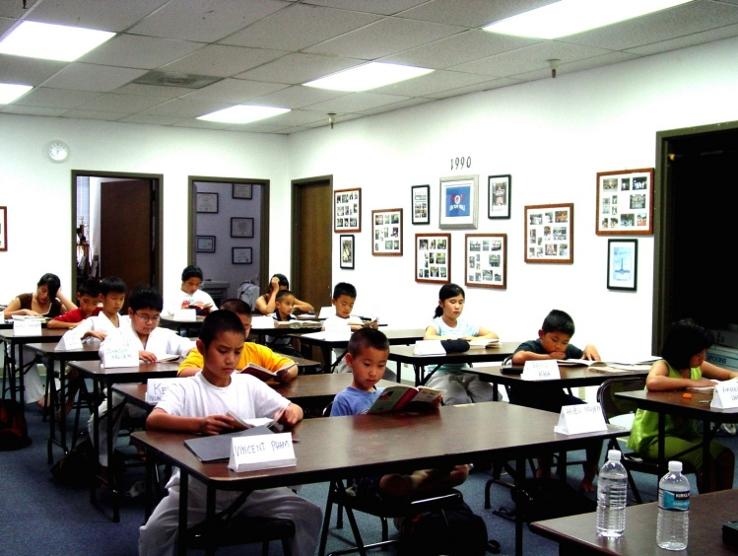

Work on your own work
without distracting others.
No Cheating
No Noises
No Horseplay

Slide 5
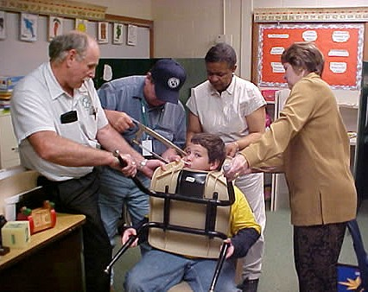
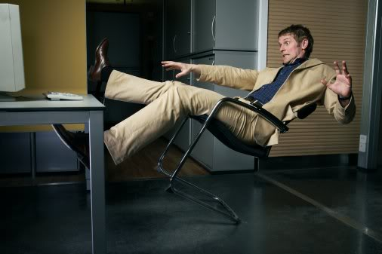
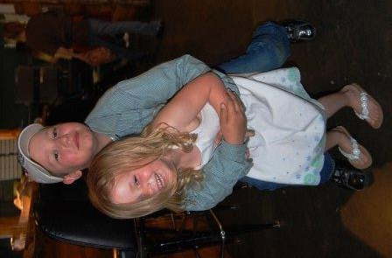
No Horseplay
Horseplay is defined as acts of goofing off that is not necessary for a productive classroom environment.
This includes but is not limited to throwing things, leaning back in your chair, hanging on rafters, hitting, tripping, and touching others.

Slide 6


Keep your teacher happy
If you know it is wrong, unsafe, impolite, not appropriate, or unacceptable then DON’T DO IT!

