Slide 1
Stop Bullying
By: CB

Slide 2
Bullying is not cool. Everyone is taking a stand, don’t you want to be a cool person?

Slide 3
You say bullying isn’t your problem. So you want kids to get beat up?

Slide 4
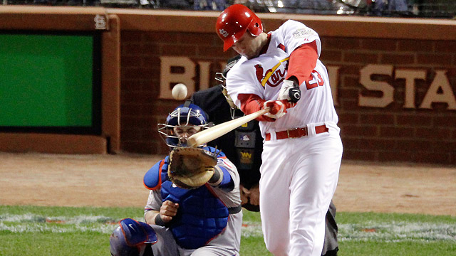
MVP of the 2011 world series, David Freese, stands up to bullying

Slide 5
Bullying can be resolved by not bullying.

Slide 6
If you don’t stop bullying from happening, you must be a bully.

Slide 7
I used bandwagon when I said everyone is taking a stand. I used testimonial when I said David Freese was taking a stand. I used oversimplification when I said bullying can be resolved by not bullying. I used either/ or argument when I said if you don’t stop bullying you must be a bully. Also I used straw man when I said, “You say bullying isn’t your problem, so you think kids should be beat up?” I think my power point was helpful because it convinced people not to bully.

Slide 8
Cites stop bullying now picture- David Freese picture- espn.go.com title page background- wall.alphacoders.com title page picture- bigpassage.com no duh award picture- scottq.typepad.com thinking man picture- scholarixsolution.com
basma-aal.blogspot.com

